Slide 1
“ Robotic vehicle controlled by touch screen ”
Mini Project – III (20ECL59B)
Disha R Nayak 1NH20EC047
Danush Pravin 1NH20EC038
Guided By
Ms Salna Joy
// Assistant Professor/Senior Assistant Professor/ Associate Professor/Professor
Dept. of ECE
New Horizon College of Engineering, Bengaluru
11/28/22

Slide 2
Contents
Introduction
Literature Review
Existing System
Problem Statement & Objectives
Proposed System
Block Diagram
Hardware & Software Specification
References
Progress Work
Milestones/Schedule/Timeline
11/28/22

Slide 3
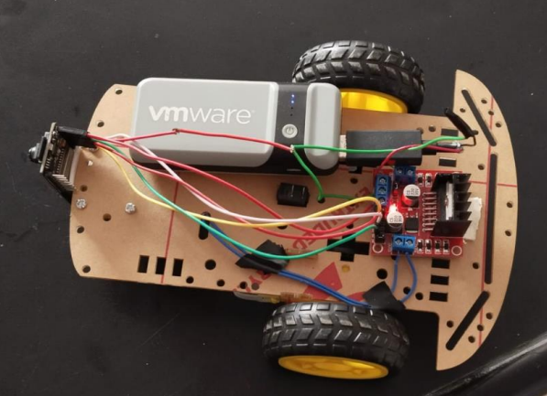
Introduction
11/28/22

Slide 4
Literature Review
“Remotely controlled autonomous robot using Android application”, Authors: S. S. Pujari, M. S. Patil, and S. S. Ingleshwar, Year: 2017 A robot was designed by S Pujari, S S Ingleshwar and M S Patil to monitor children. The aim of this project was to help the working families to monitor their children with the help of a camera. WiFi and Bluetooth modules were used. A camera module and Raspberry Pi 3 was used by the robot. They used Python language.
. “Multiple motion control systems of the robotic car based on IoT to produce cloud service,” Authors: M. R. Mishi, R. Bibi, and T. Ahsan Year: 2017 A robotic car was designed by Mr. Mishi using Arduino UNO and Raspberry Pi. These two controllers were together used to control the robot in this project. This car had the features that allowed tracing the car and detect the obstacles. The path could be measured. The data was in the cloud. This allowed offline operations.
“Android application based monitoring and controlling of movement of a remotely controlled robotic car mounted with various sensors via Bluetooth,” Authors: D. Chakraborty, K. Sharma, R. K. Roy, H. Singh, and T. Bezboruah, Year:2016 This model which was developed by D. Chakraborthy had sensors and the Bluetooth technology. The communication was established between the robot and the smart device. Ultrasonic ranging sensor was used to detect the obstacles in order to avoid collision. The robot had the camera. The images taken by the robot were later used form analysis
11/28/22

Slide 5
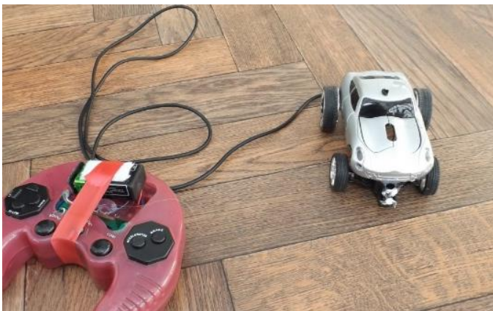
Existing System
11/28/22

Slide 6
Problem Statement & Objectives
Problem Statement:
To develop a prototype of a smartphone-controlled robot car
Objectives:
The aim of this project is to develop a prototype of a smartphone-controlled robot car that performs a various function in order to provide a very powerful and versatile robot while also reducing the hardware usage as much as possible.
11/28/22

Slide 7
Proposed System
A web page which can be accessed using any device with internet connection is used to send commands. Commands are sent from the transmitter at transmitter end to the receiver at receiver’s end to control the movement of the robotic vehicle in forward, backward, right or left directions. A touch screen device is used to control these movements. The two dc motors are interfaced to the microcontroller. The robot is controlled through Wi-Fi using ESP32-CAM. A web page is used to control the robotic vehicle, that can be accessed in any type of device inside our local network.
11/28/22

Slide 8
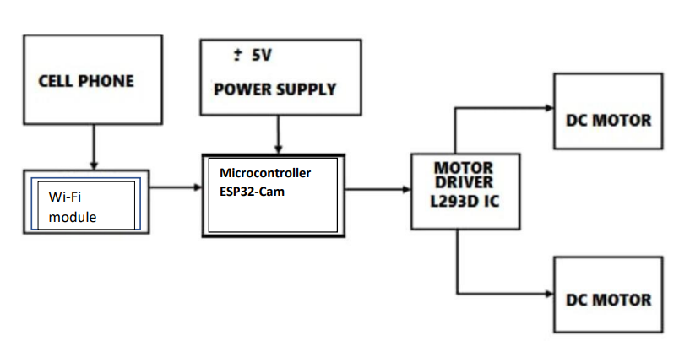
Block Diagram
11/28/22

Slide 9
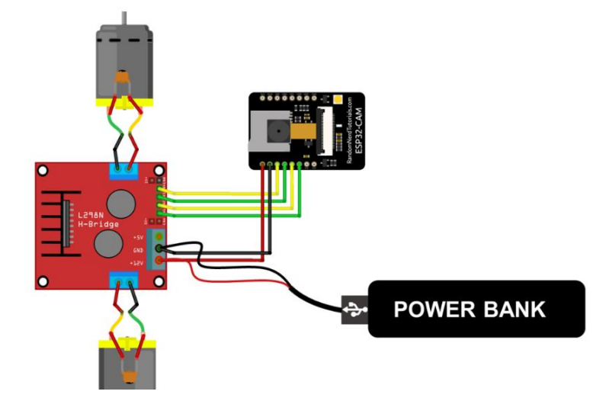
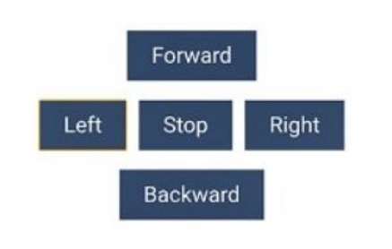

Slide 10
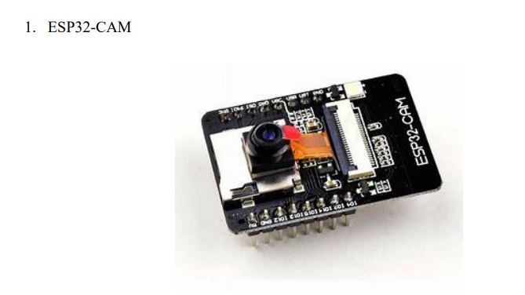
Hardware & Software Specification
11/28/22

Slide 11
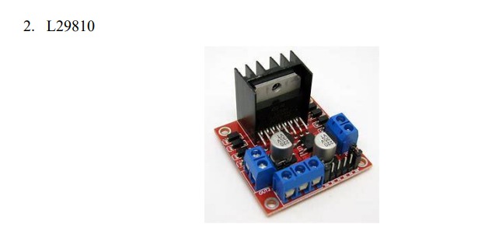

Slide 12
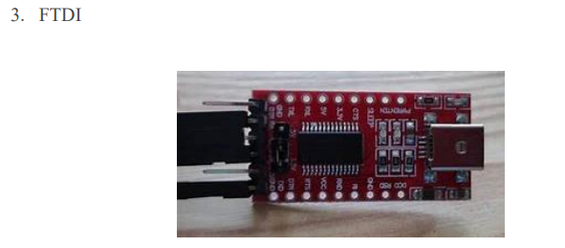

Slide 13
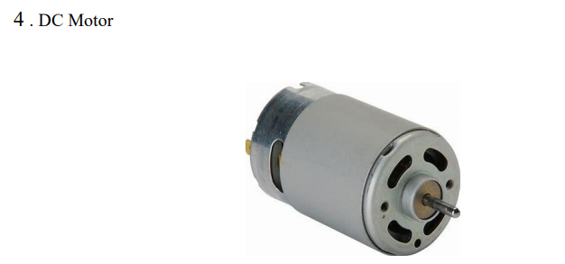

Slide 14
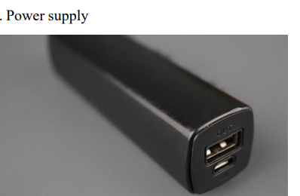

Slide 15
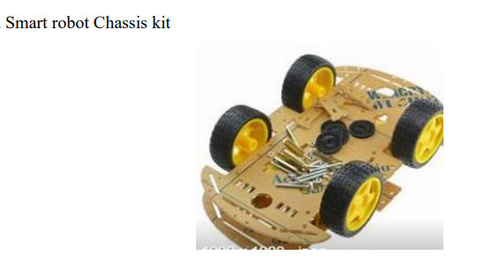

Slide 16
Advantages and Applications
The advantages of this project are as follows:
• Minimum hardware requirements.
• Simple and inexpensive.
• The robot can be controlled even if it’s out of sight.
• Small in size.
• The circuitry is simple.
Applications:
• Home: Cleaning, security systems
• Military & defence: As a weapon, search, rescue and attack
• Agriculture: Monitoring
• Mining
• Outer space: Space exploration

Slide 17
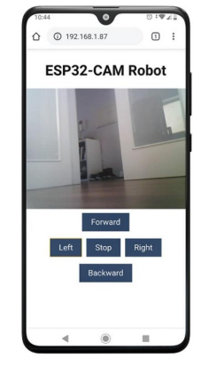
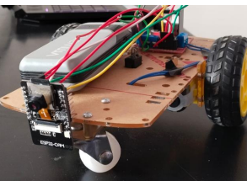
Results and Conclusions

Slide 18
Future Scope
Autonomous bot
Autonomous bot can be built using ultrasonic sensors. This bot can be designed in such a way that it can move around on its own without crashing into any obstacles. While the bot moves around the video streaming allows the user to monitor the motion of the robot.
The ultrasonic sensor can be used to plot a 2d map of its surroundings. It can detect the obstacles in its way and select the best path for itself.
Domestic or household robots – These bots can be used to perform household tasks. This robot can be used monitor children

Slide 19
References
[1] S. S. Pujari, M. S. Patil, and S. S. Ingleshwar, “Remotely controlled autonomous robot using Android application”, 2017 IEEE International Conference on I-SMAC (IoT in Social, Mobile, Analytics, and Cloud) (I-SMAC), 2017.
[2] M. R. Mishi, R. Bibi, and T. Ahsan, “Multiple motion control systems of the robotic car based on IoT to produce cloud service,” 2017 IEEE International Conference on Electrical, Computer and Communication Engineering (ECCE), 2017
[3] D. Chakraborty, K. Sharma, R. K. Roy, H. Singh, and T. Bezboruah, “Android application based monitoring and controlling of movement of a remotely controlled robotic car mounted with various sensors via Bluetooth,” 2016 IEEE International Conference on Advances in Electrical, Electronic and Systems Engineering (ICAEES), 2016
11/28/22

Slide 20
Milestones/Schedule
Milestone | Baseline Date | Target Date | Achievement
11/28/22

Slide 21
Thank You
11/28/22

